Slide 1
https://www.youtube.com/watch?v=A6vhnEjmq2I

Slide 2
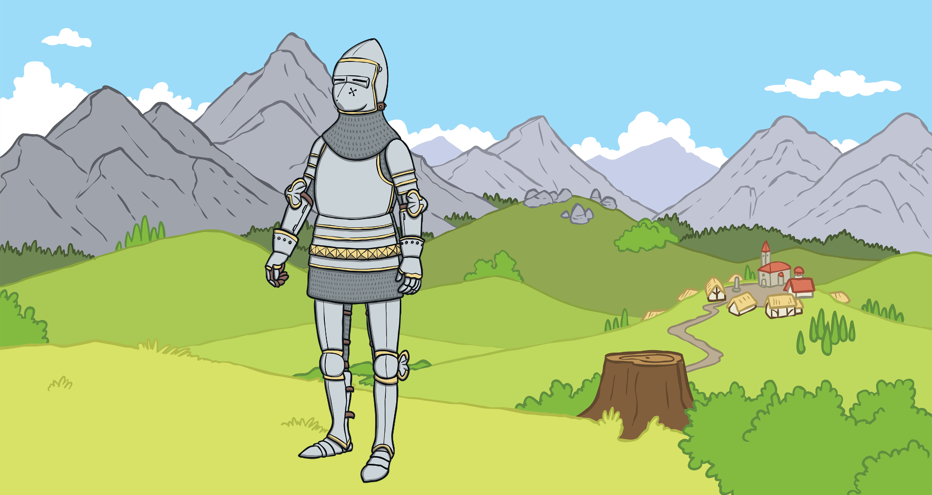
Once upon a time there lived a knight called George.

Slide 3
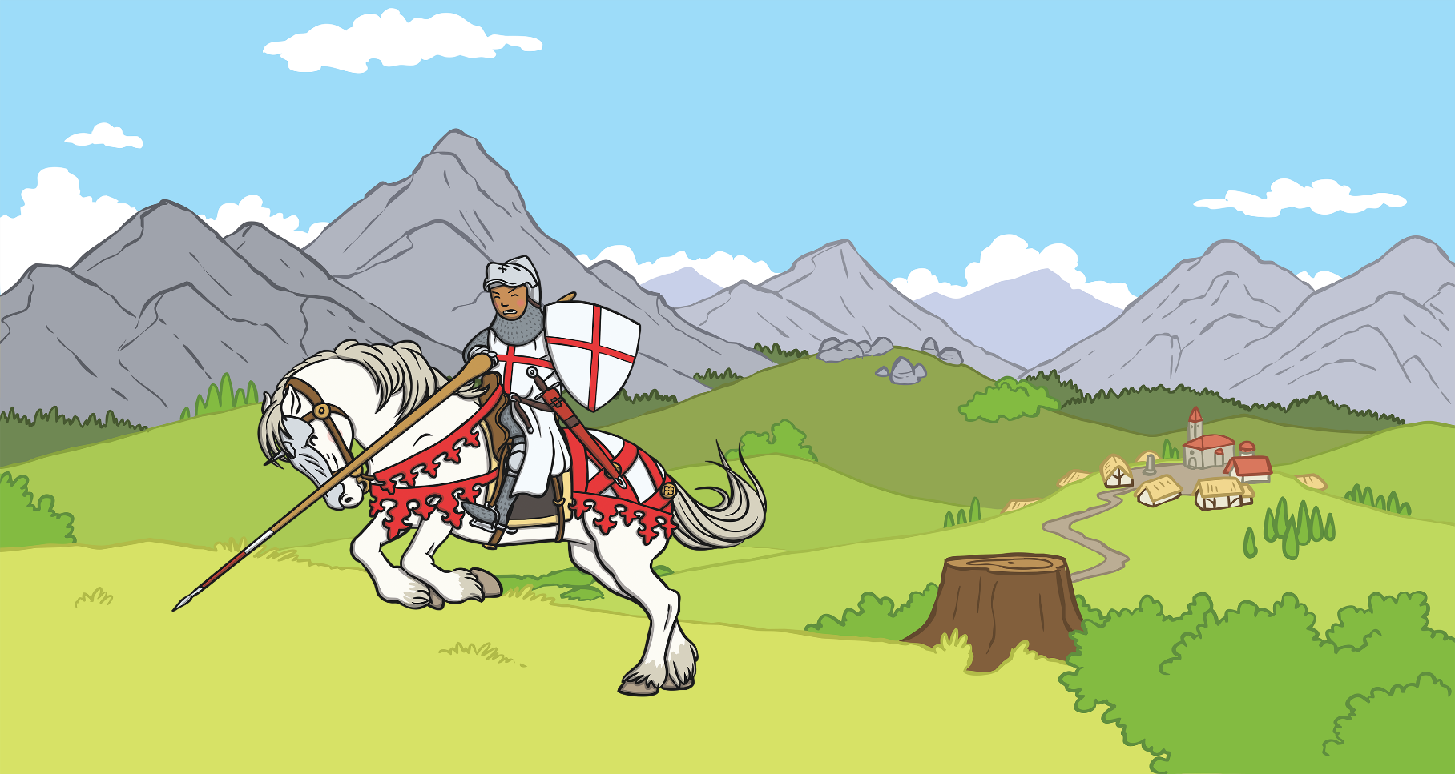
During his many travels he came across a village.

Slide 4
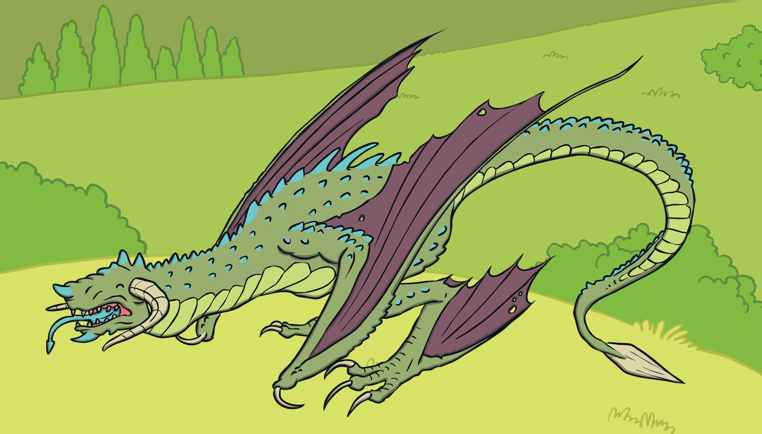
The villagers were very unhappy because of a dragon that lived in a nearby lake.

Slide 5
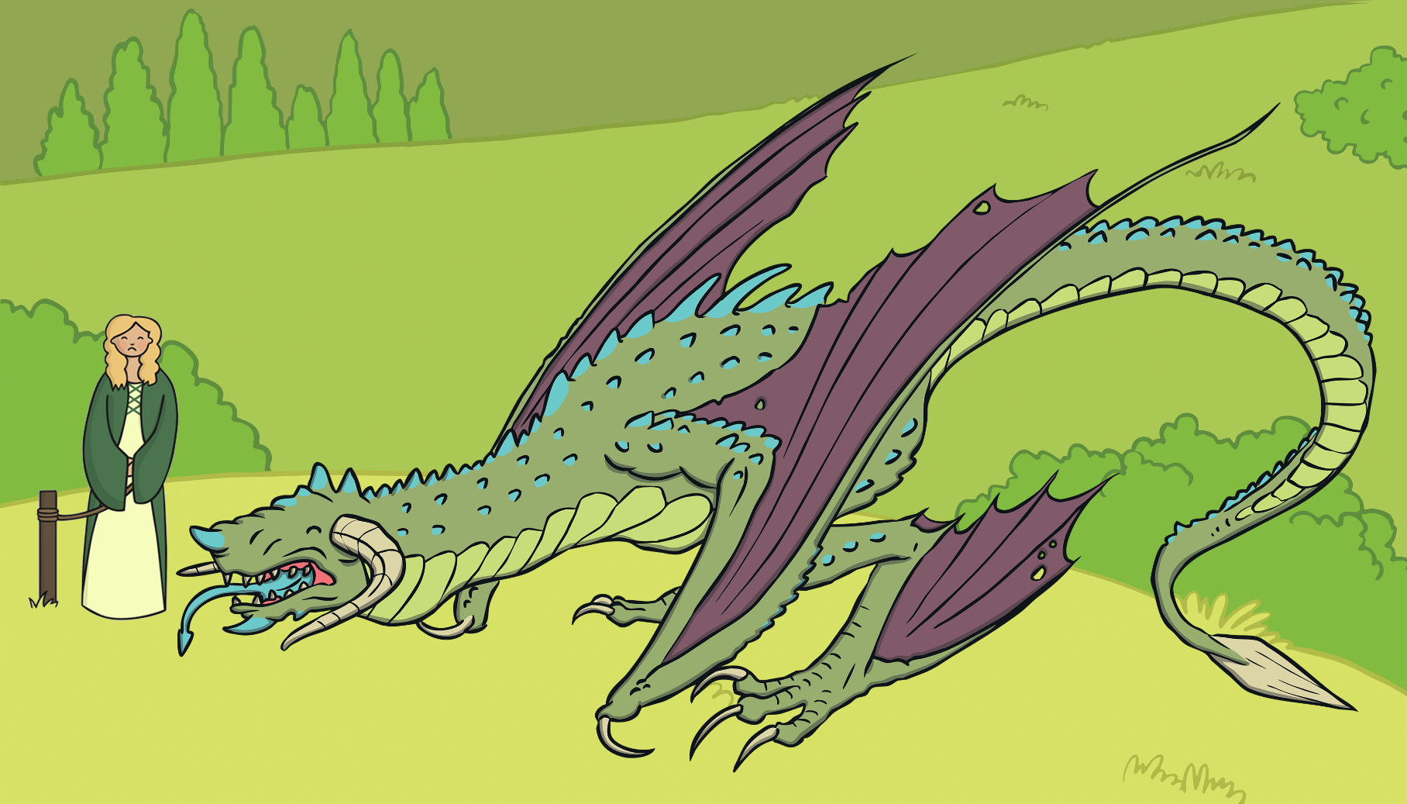
Every day the dragon demanded that they sacrifice a beautiful maiden.

Slide 6
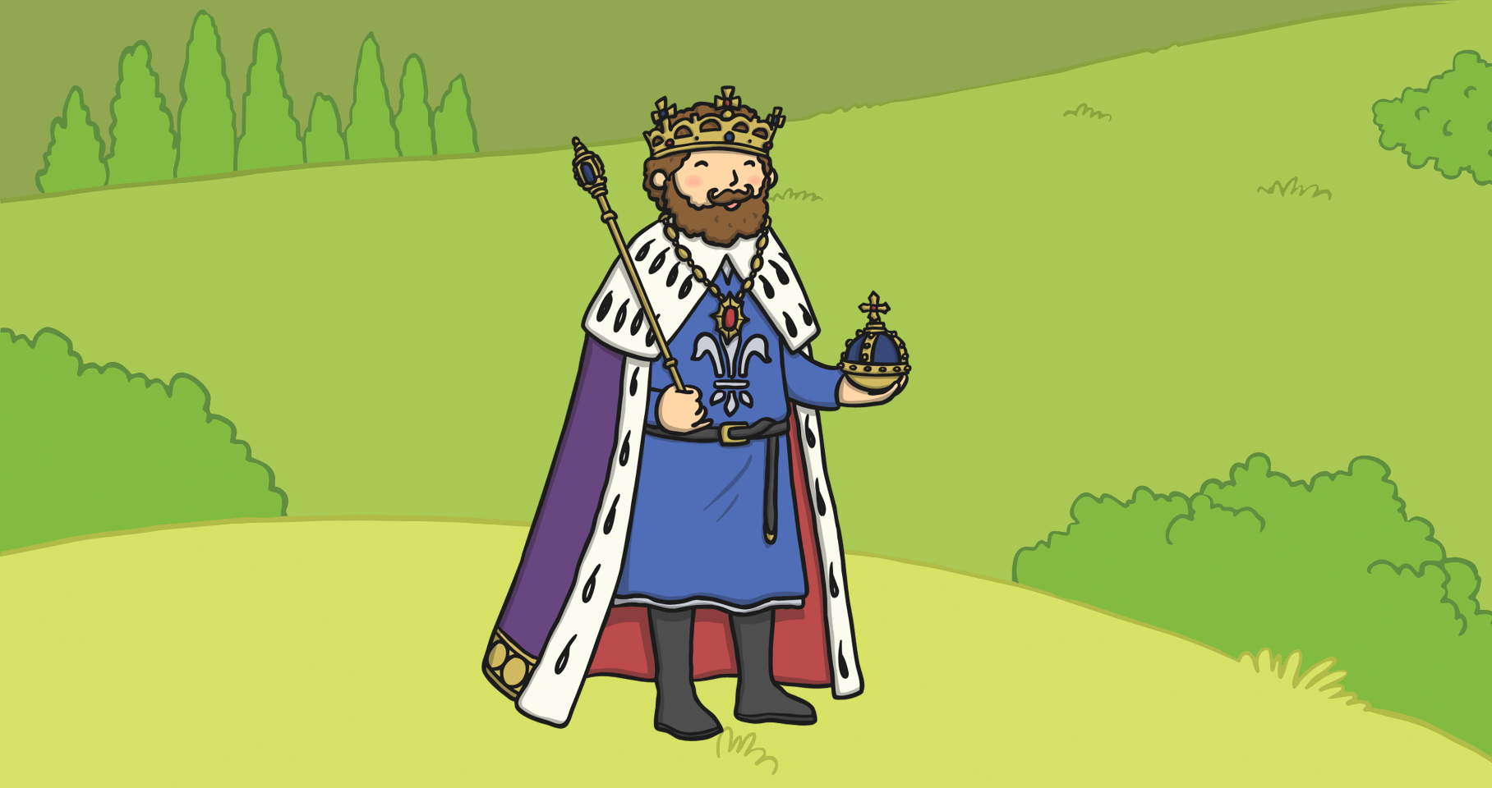
The maidens were chosen by lottery.
That day the lot fell on the king’s daughter.

Slide 7
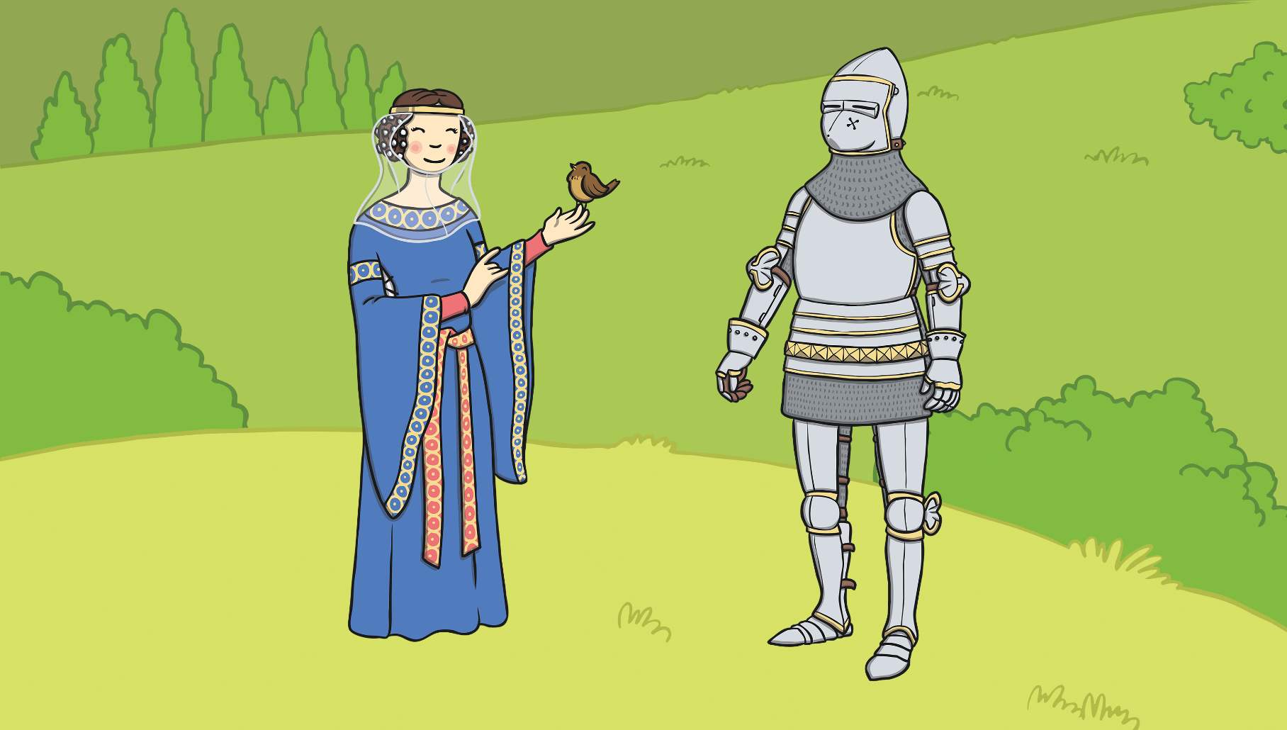
George decided to slay the dragon and save the princess.

Slide 8
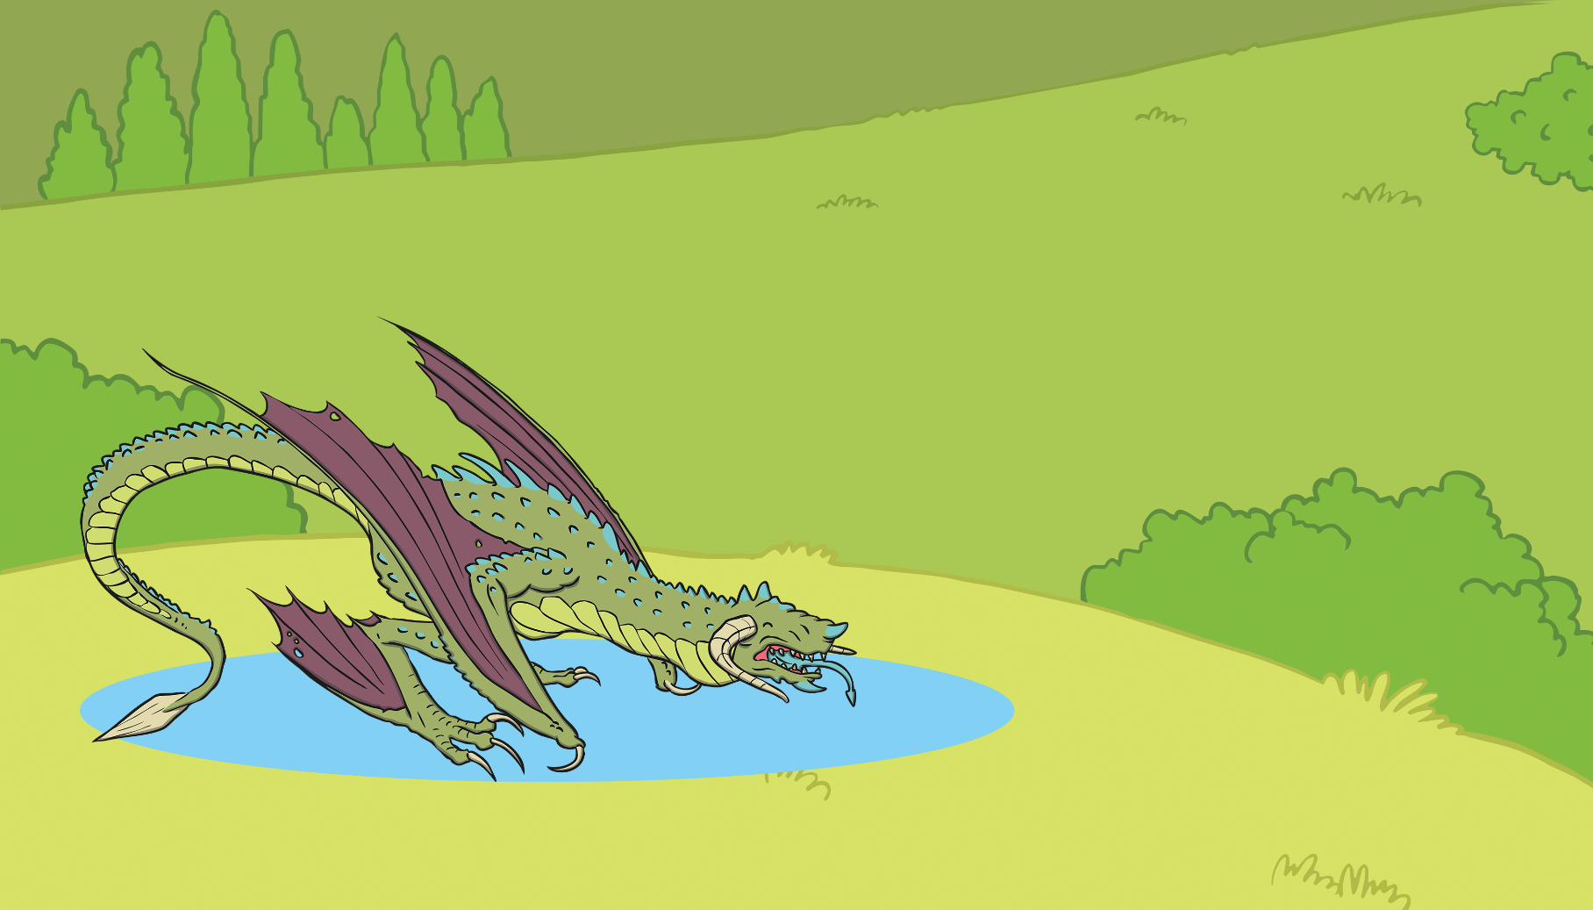
George went to the lake where the dragon lived.
The dragon rose out of the water with a mighty roar!

Slide 9
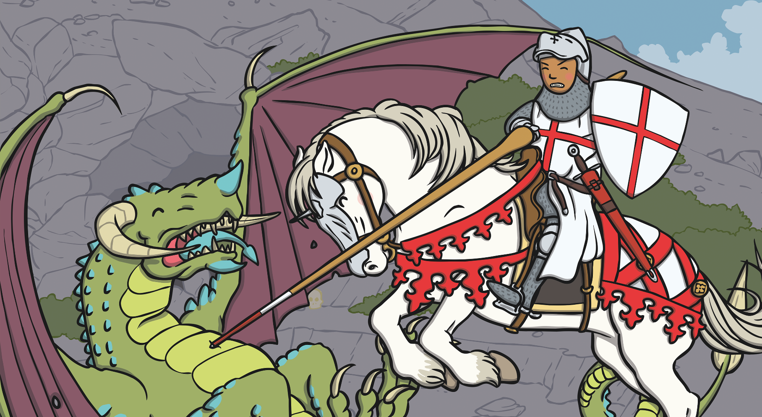
George wasn’t scared. He fought the dragon with all his strength until it was defeated.

Slide 10
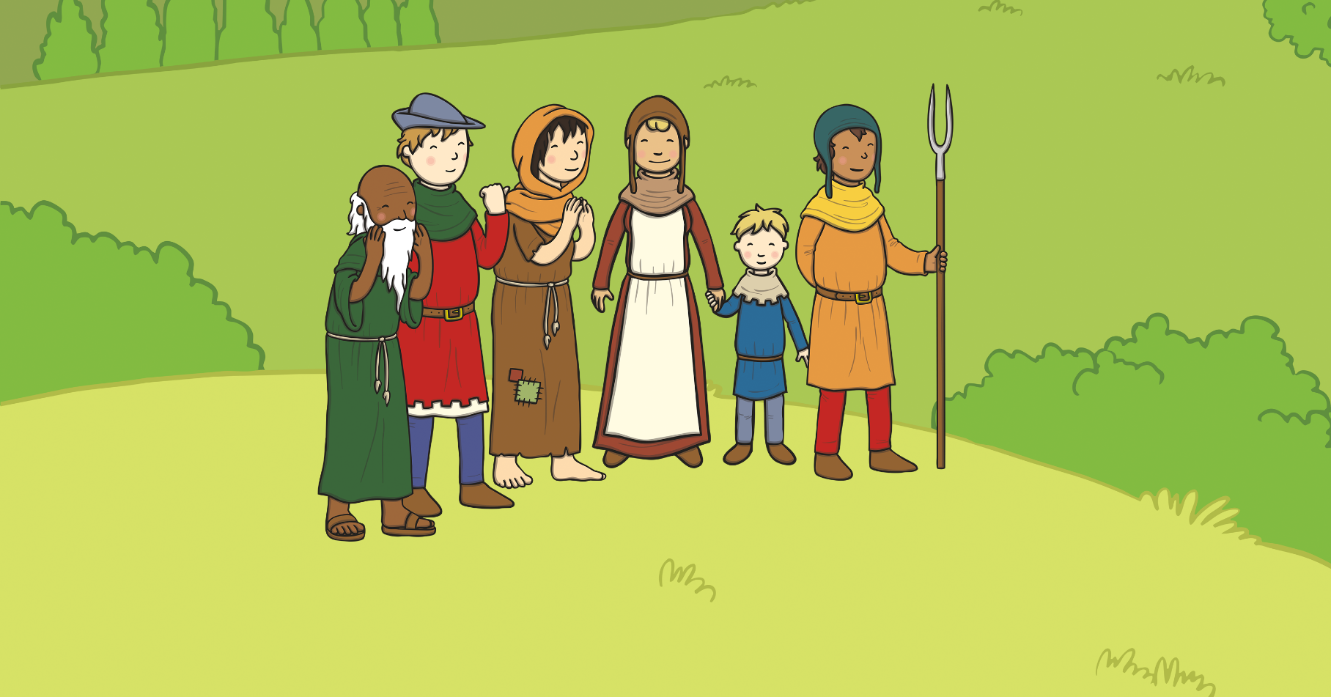
The princess was saved and the villagers were overjoyed!

