Slide 2
What types of clothing do the Police Wear?

Slide 3
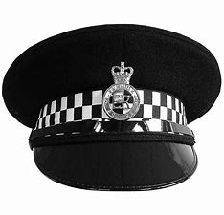
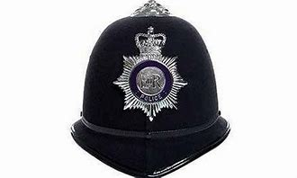
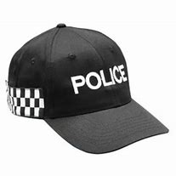
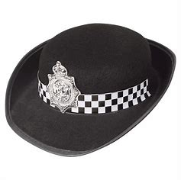
Helmet/hat

Slide 4
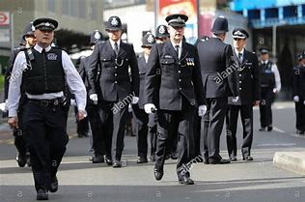
Uniforms

Slide 5
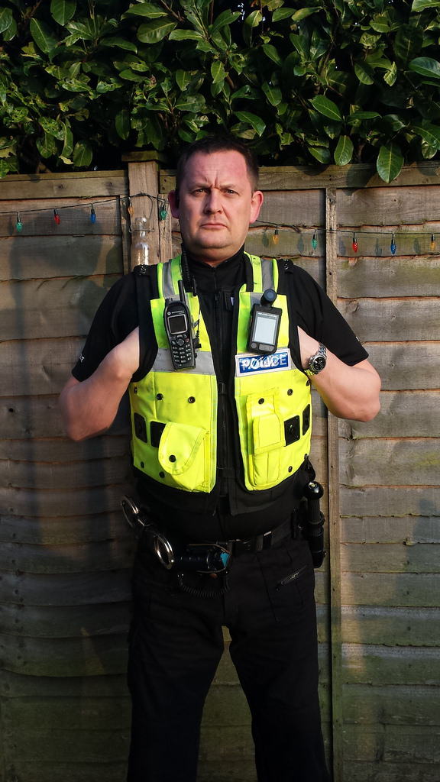
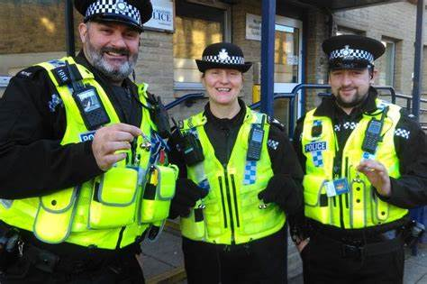
High Visibility Jackets/ Vests

Slide 6
What tools does a police officer use and carry?

Slide 7
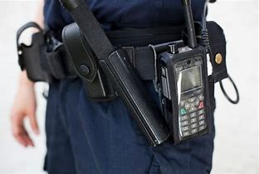
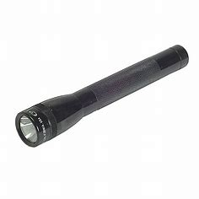
Carry a Torch
Carry Walkie Talkies

Slide 8
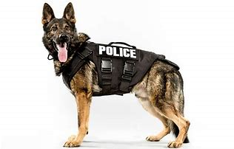
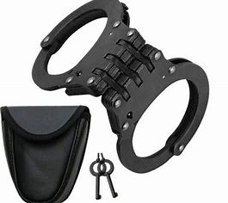
Police use Dogs
Police carry handcuffs

Slide 9
What types of transport do police use?

Slide 10
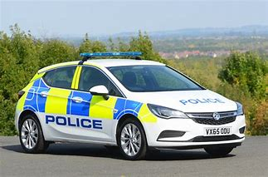
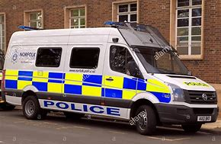
Police Car
Police Van

Slide 11
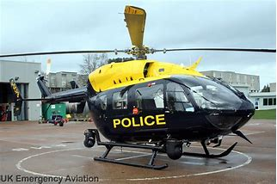
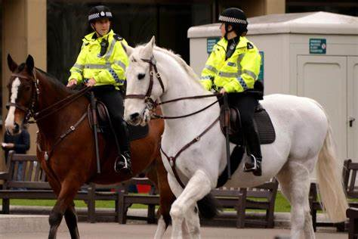
Police Helicopter
Police Horse

Slide 12
Where can you find police officers?

Slide 13
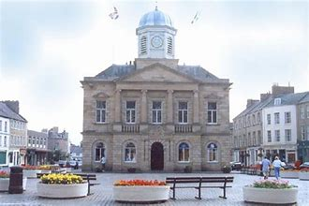
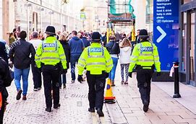
In a Town Hall
Patrolling the streets

Slide 14
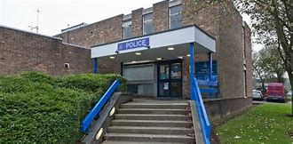
Police Station

Slide 15
What skills do police officers need?

Slide 16
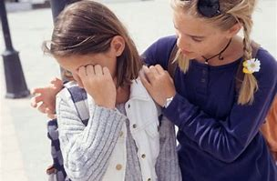
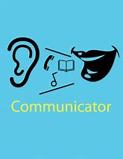
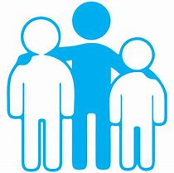
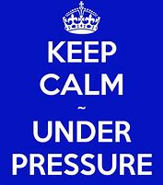
Communicator
Empathetic Personality
Team player
Organised
Stay calm under pressure

Slide 17
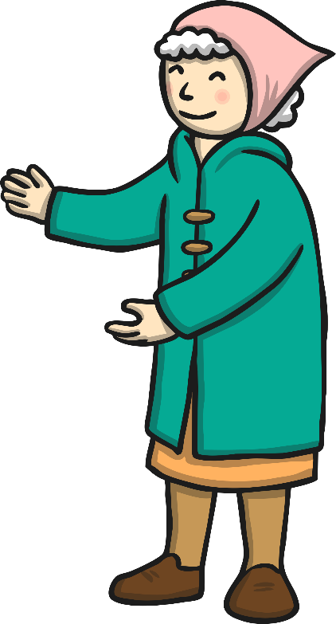
What do the Police do?
Police officers do many different things to help people, such as:
Help people with directions in town.
Help an elderly person if needed.
Help you if you get lost.
Police officers are friendly people that are there to help you.

