Slide 1
PowerPoint Instructions
First, click the show button to reveal groups of magical characters.
Then, click on the magic wand in the corner to reveal open-ended, challenging questions.
Click on the rainbow when you are ready to reveal to the children how many characters there are.
If you would like the option to cover up the characters during the discussion to avoid the children counting them too early, please click on the hide button. To reveal them, click the show button again.
This PowerPoint contains an optional problem-solving activity on the last slide.

Slide 3
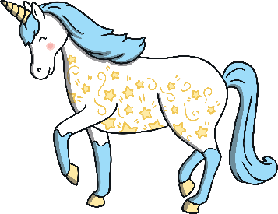
How Many Unicorns?
Can you explain what an estimation means?
Can you see any groups of unicorns? How can this help you to estimate?
How many unicorns do you estimate there are?
Click me!
5
Let’s check!
show
hide
back
next

Slide 4
How Many Wizards?
Can you describe the groups of wizards?
Do you think it will be a larger number of wizards than the unicorns?
How many wizards do you estimate there are?
Click me!
10
Let’s check!
show
hide
back
next

Slide 5
How Many Elves?
Do you think there are more or less elves than wizards? Why?
What can help you to estimate the number of elves here?
How many elves do you estimate there are?
Click me!
7
Let’s check!
show
hide
back
next

Slide 6
How Many Witches?
Can you tell me about how the witches are grouped?
Would 20 be a close estimate for the number of witches? Why not?
How many witches do you estimate there are?
Click me!
6
Let’s check!
show
hide
back
next

Slide 7
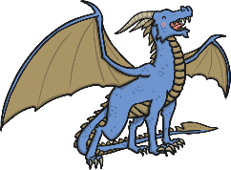
How Many Dragons?
I can see a dragon on its own here, what can you see?
Do you think there are a large number of dragons? Why?
How many dragons do you estimate there are?
Click me!
9
Let’s check!
show
hide
back
next

Slide 8
Problem-Solving Slide
?
?
The eight witches have lost their wands and hats!
Without counting, can you tell me:
Do you think there will there be enough wands there for each witch?
Why not? How do you know?
Do you think there will there be enough hats for each witch?
Can you tell me a little bit more about why you think this?
Let’s count to check!
back
end

