Slide 1
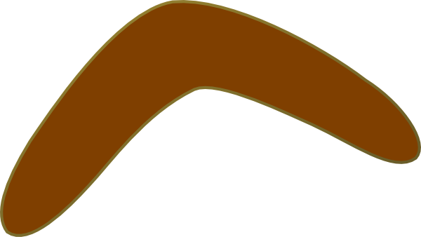
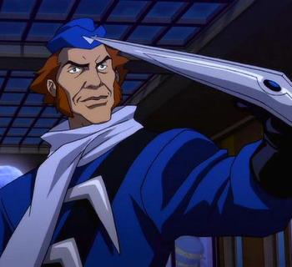
Superhero Dr Boomerang Head

Slide 2
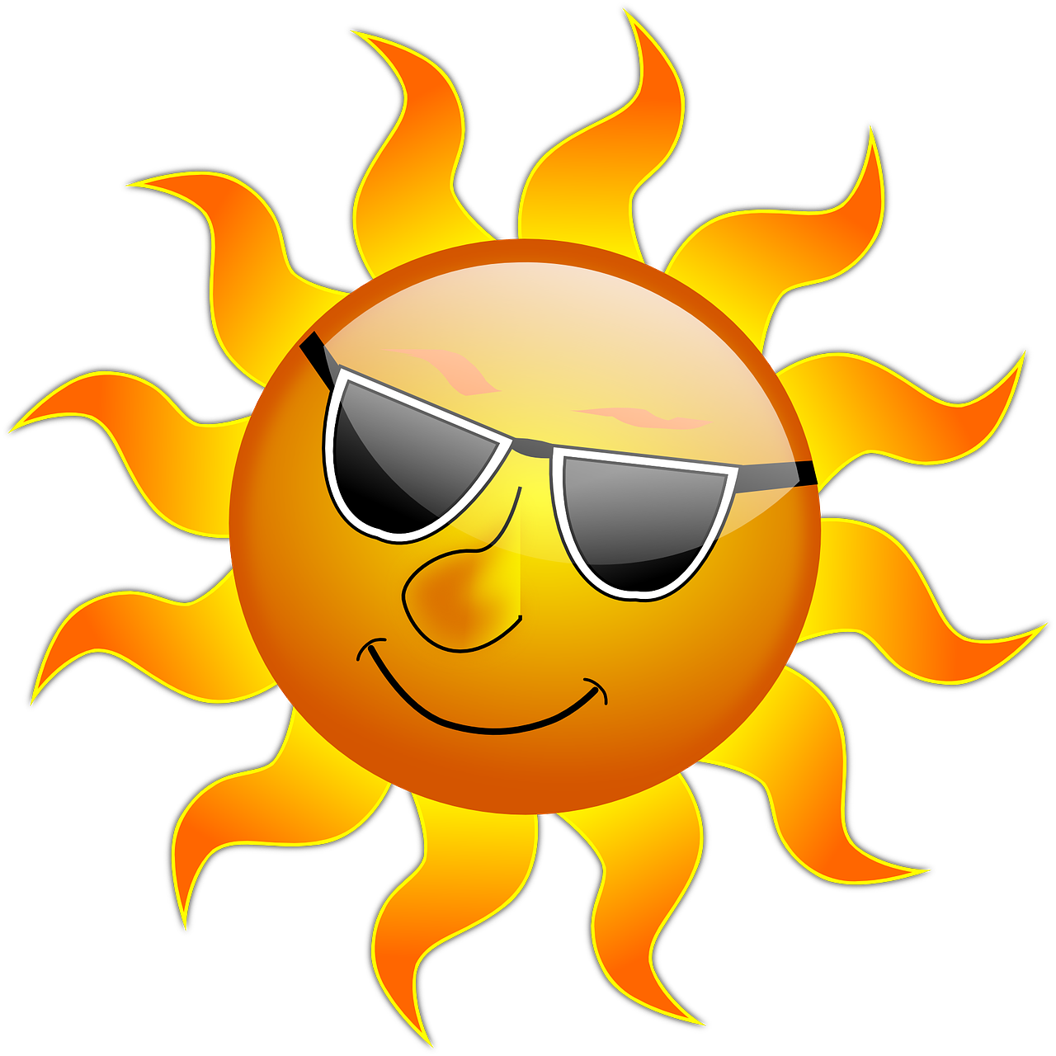
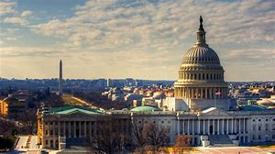
One day in Washington DC on a hot summers day, the lovely people wondered the streets carrying out their daily chores. All of a sudden they began to feel a rumble beneath their feet which made the people sway back and forth.
You could feel the heat upon your cheeks, smell lavender from the fields in the air and lemon trees nearby!

Slide 3
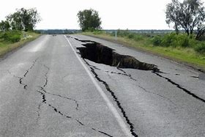
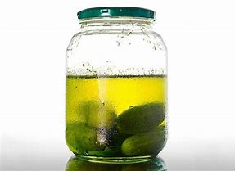
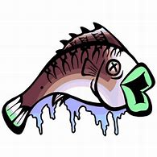
Huge cracks split the roads in half and a horrible smell filled the peoples nostrils. It smelt like rotten fish and gherkin juice.

Slide 4
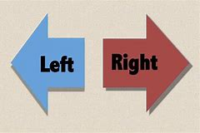
Everyone started to panic and run in opposite directions, some went left, some went right, others ran down the stairs towards the underground railway station.

Slide 5
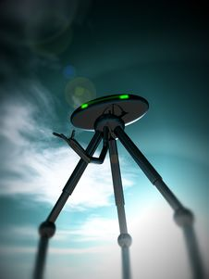
“What ever shall we do” shouted one person.
“What is happening” shouted another person.
The cracks began to get bigger and a ginormous shape began to surface from beneath the ground. It looked like a tripod with a silver saucer for a head. It was as big as the tallest skyscraper, 1 hand with fingers and 2 green eyes with 3 legs to support it.
Try on Green Glasses

Slide 6
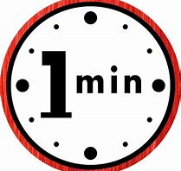
The people of Washington DC stopped in their tracks and turned towards the metal tripod monster.
For about a minute the monster and people stared at each other.
All of a sudden the monster gave out a big “roarrrrrrrrrrrrr” and the people began to run again.
Make the noise of the monster

Slide 7
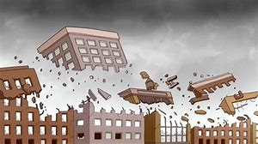
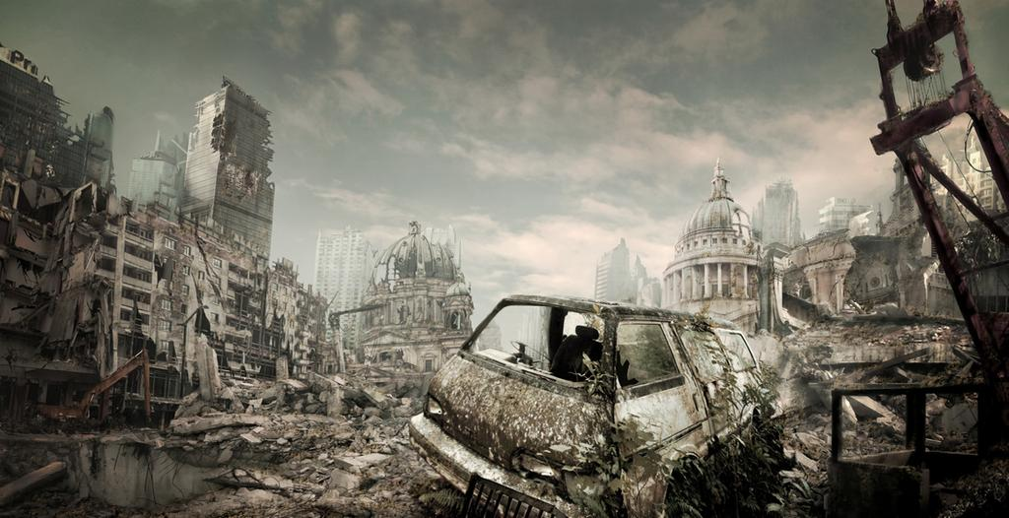
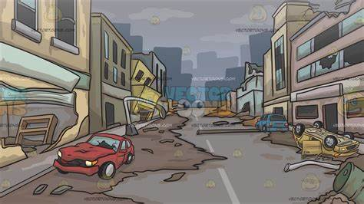
It crushed buildings with its 3 legs and threw cars with its arm. It had a red zapper in the middle of its saucer head and began to ‘zap, zap, zap’ buildings away – they disappeared without a trace.
“Who will save us” one person cried.
Wait who is that guy” cried another.

Slide 8
“It’s Dr Boomerang Head” people near by shouted!

Slide 9
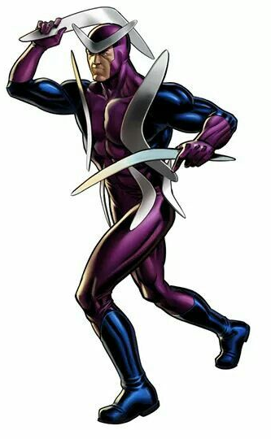
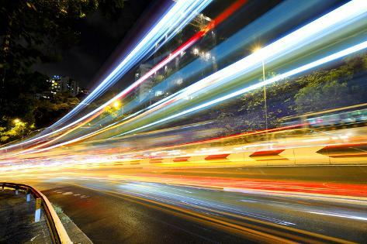
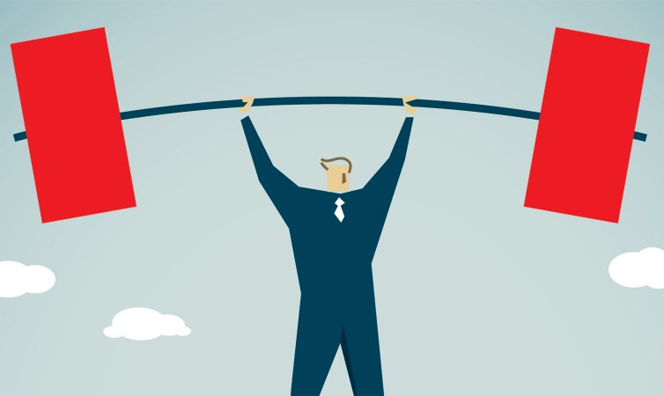
He could run as fast as lightening, and stronger then a million men but his favourite superpower was his boomerang, which he could aim and throw and it would always hit his targets by exploding them into a thousand pieces.

Slide 10
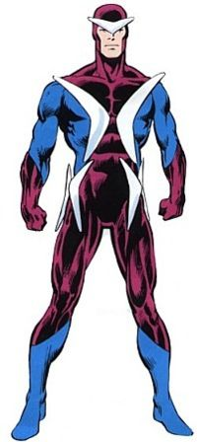
“Do not fear good people of Washington DC, I will save you and defeat this monster once and for all!”
Dr Boomerang Head ran really fast towards the monster that began to aim it’s zapper towards the superhero. Dr Boomerang Head dogged the zaps, moving left, right, up and down. Each time the monster tried to zap him.
Hide under blanket to escape.

Slide 11
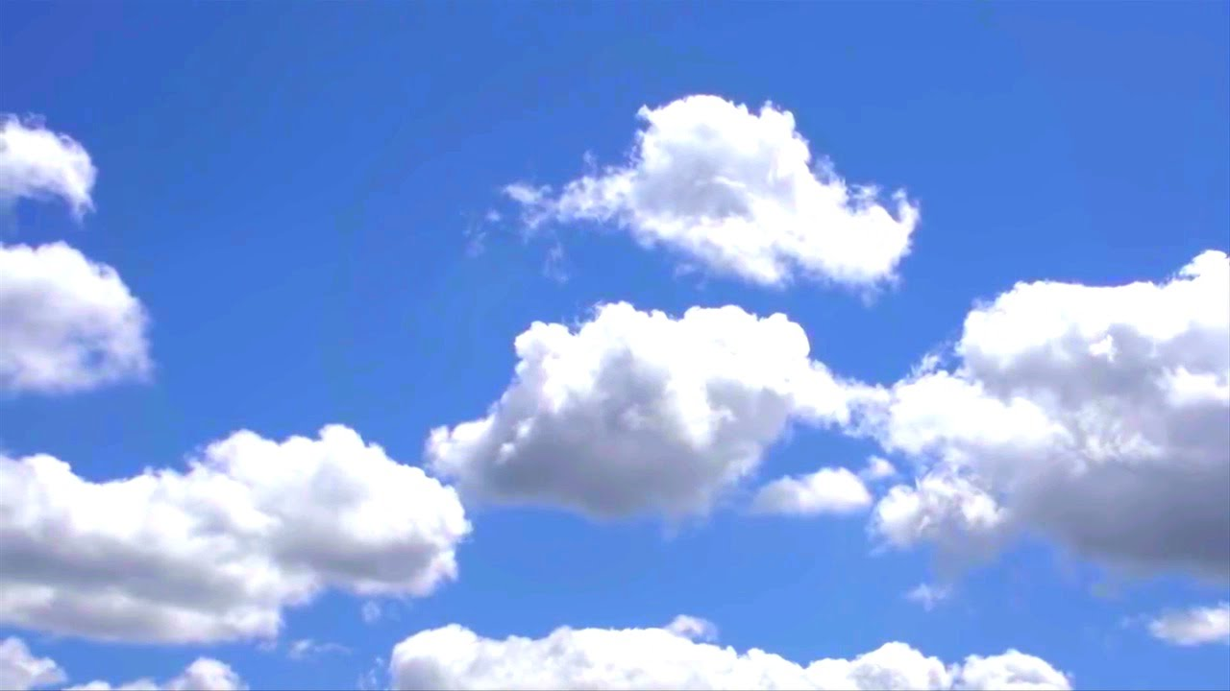
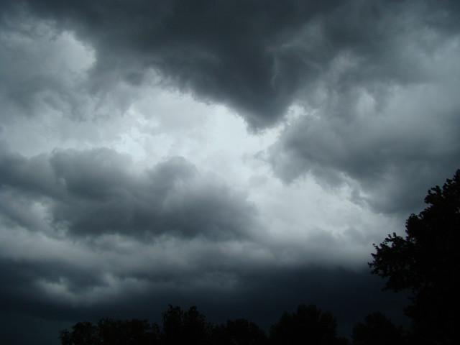
The sky began to turn black and thunder storms began to crack through the clouds. Dr Boomerang Head took his boomerang from on top of his head and aimed it towards the monster.
Smell of rain

Slide 12
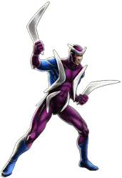
The boomerang hit one of the monsters legs which made the silver saucer head monster wobble and fall too the ground. As the monster fell to the ground, it gave an all mighty shriek and crushed some buildings on it’s way down.

Slide 13
The monster began to get up and run towards Dr Boomerang Head, heavy footsteps you could probably hear from miles away.
Dr Boomerang ducked underneath the monster and threw another Boomerang at the monsters legs.
The monster was done, with only one leg left, he could not keep himself up and fell to the ground again.

Slide 14
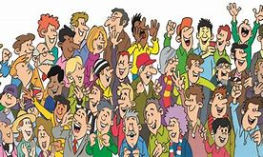
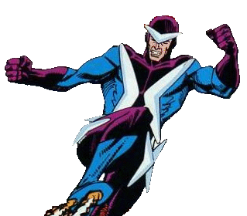
‘The people of Washington DC gave an almighty cheer for Dr Boomerang Head – hip hip hooray’.
The People were saved, the monster was taken away by the helicopter police.

Slide 15
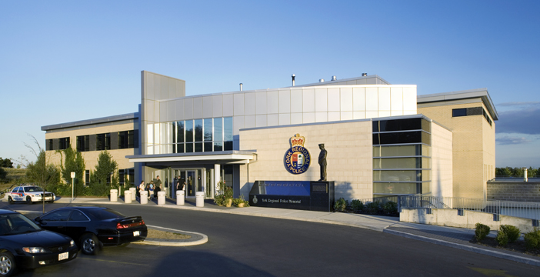
The next day, back in police head quarters where they kept the monster. The police kept the monster to study and observe, to understand where the monster came from and how it survived under the ground for all this time. The monster was dead so the people thought.
Until it began to open it’s eyes………

