Slide 1
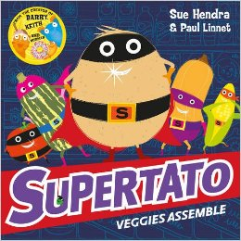
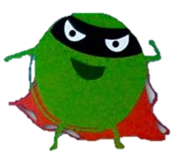

Slide 2
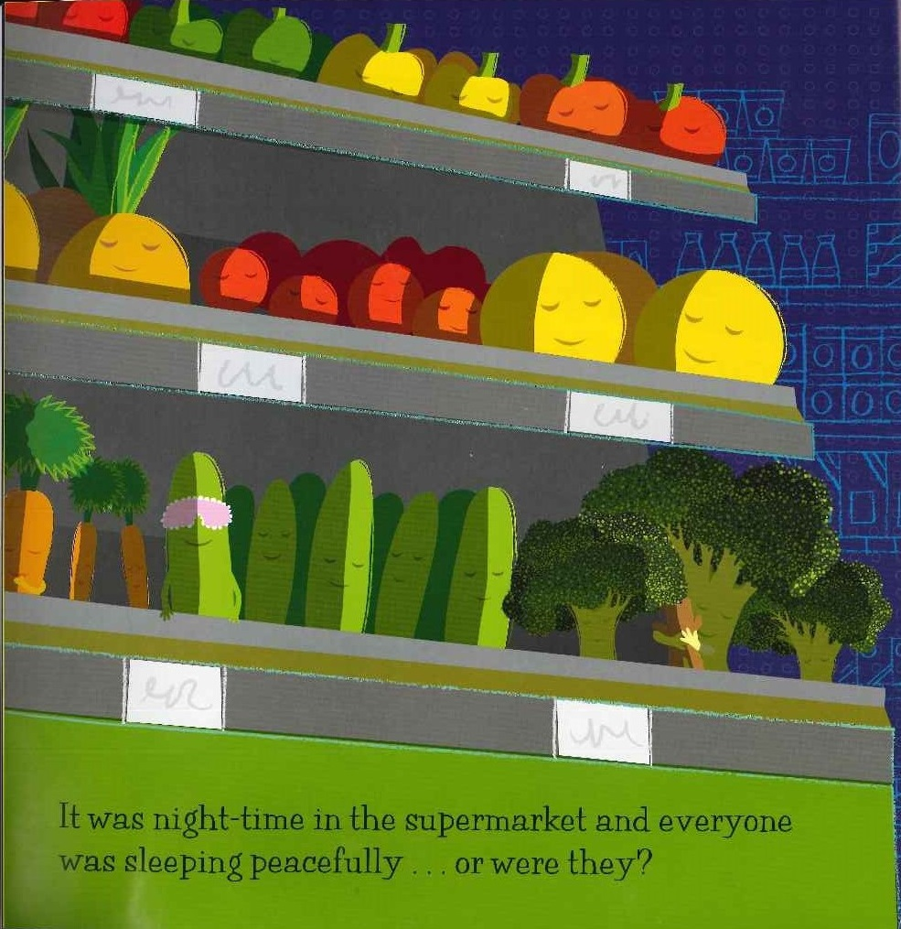
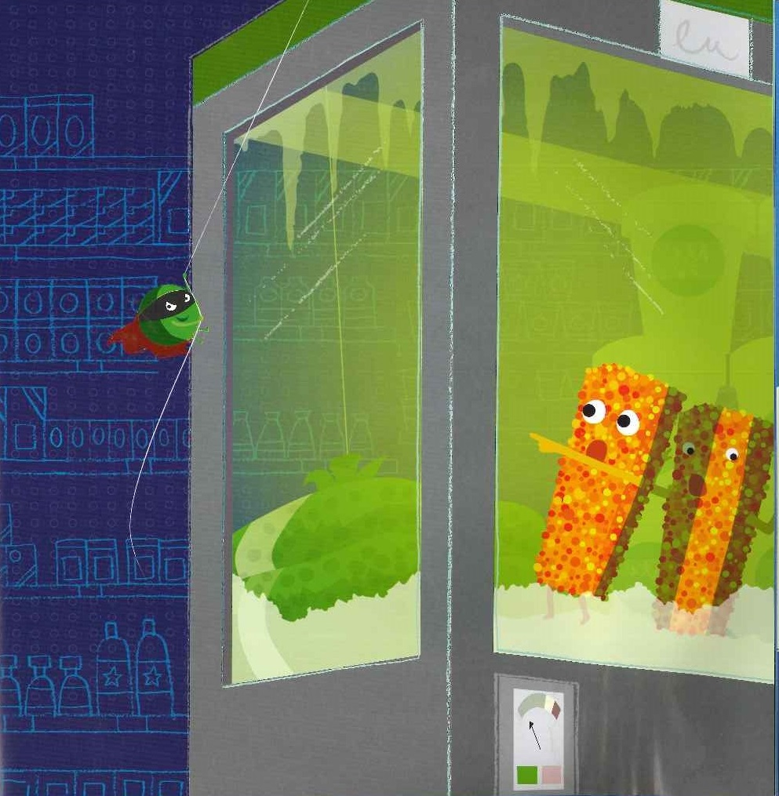
It was night-time in the supermarket and everyone was sleeping peacefully…or were they?

Slide 3
Someone was looking for trouble.
“Mwah ha ha ha ha, soon this supermarket will be mine, All mine!”

Slide 4
You may already know this, but some vegetables are frozen for a very good reason. If they defrost they turn bad-really bad. And baddest of them all is The Evil Pea!
“Wakey wakey!” he called.

Slide 5
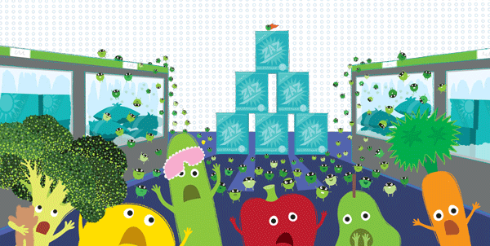
One evil pea is bad enough.
But now there were BAGS of them!

Slide 7
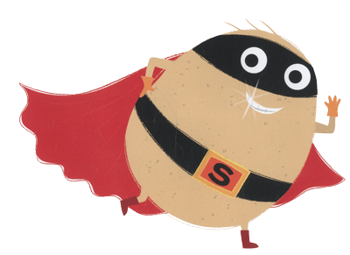
SUPERTATO TO THE RESCUE

Slide 8
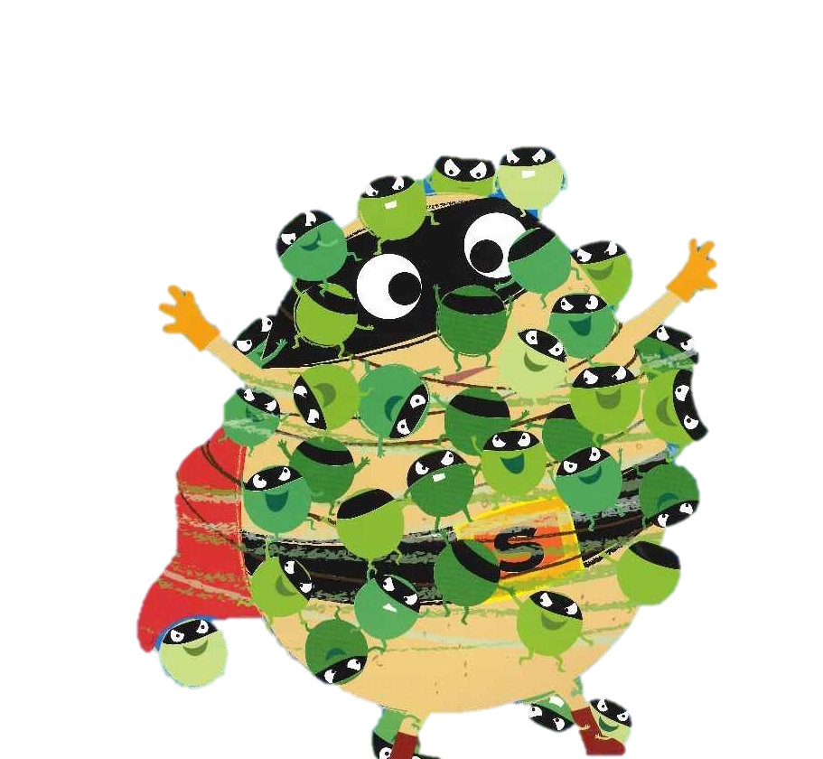
But, before Supertato could save anyone, he was attacked by a swarm of peas!

Slide 9
“We’re DOOMED!” cried Cucumber.
Things are going from bad to worse.

Slide 11
“I’m going… to need… some… backup. If I can just call the…”

Slide 12
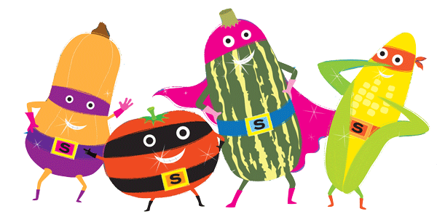
SUPERVEGGIES TO THE RESCUE!

Slide 13
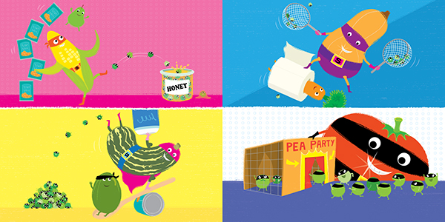
They used ninja know-how!
HI-YA!
They used fancy footwork
They used MASSIVE muscles!

Slide 14
“Sorry I’m late, I just needed to pick up some dessert!”

Slide 16
“Who ordered the vegetables?” screeched The Evil Pea.

Slide 17
Supertato!!

Slide 18
POW !

Slide 19
ZAPP!

Slide 20
BLAST!

Slide 21
Supertato caught the Evil Pea!

Slide 22
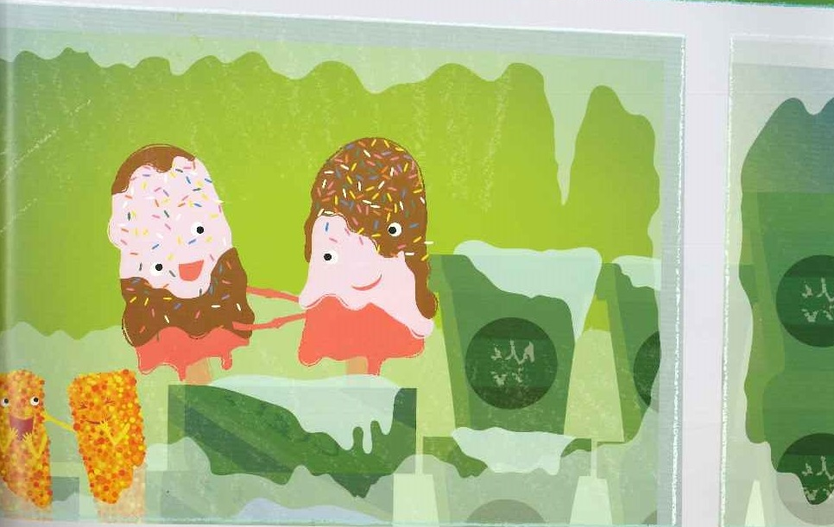
So, with the peas back in their bags and the freezers locked…
The supermarket was once again a safe place to be.

Slide 23
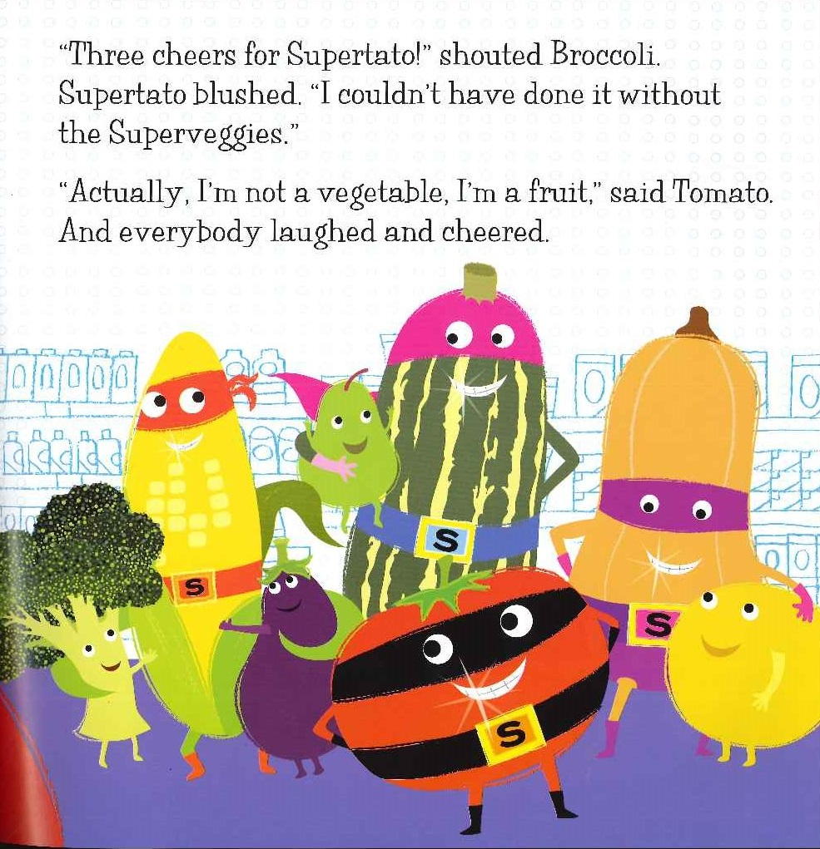
“Three cheers for Supertato!”

Slide 24
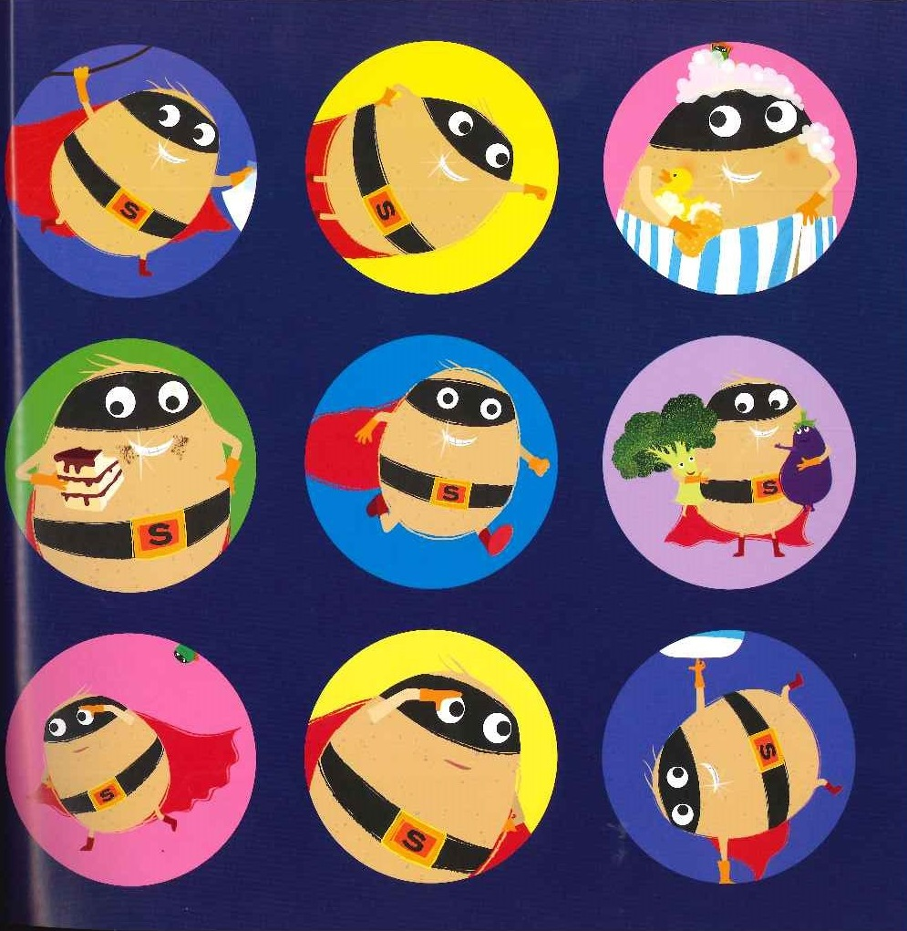
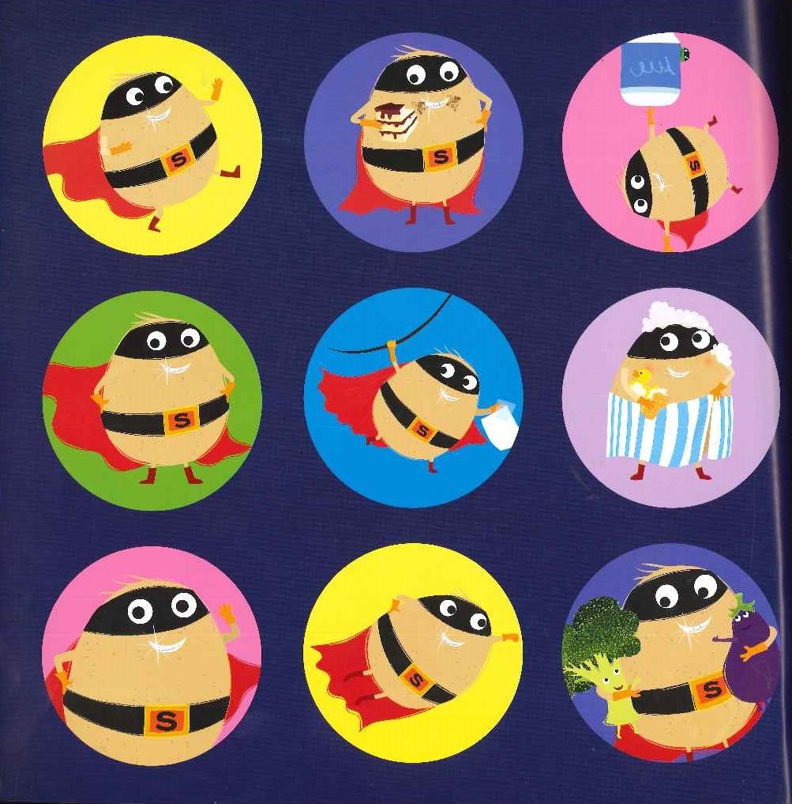
The End

