Slide 1
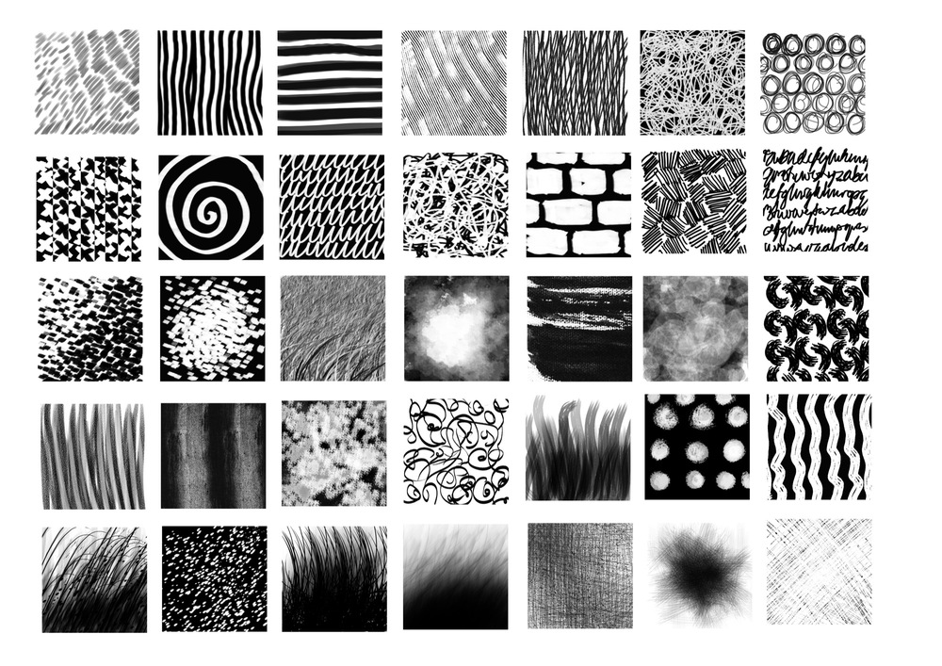
Mark Making

Slide 2
Grey Wavy Lines
Can you find this on your sheet
Batman

Slide 4
Red Stars
Can you find this on your sheet
Spiderman

Slide 6
Yellow up and down zig zags
Can you find this on your sheet
Wonder Woman

Slide 8
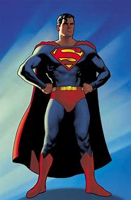
Blue Scribbles
Can you find this on your sheet
Superman

Slide 10
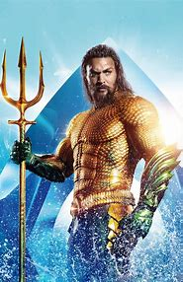
Blue spirals
Can you find this on your sheet
Aquaman

Slide 12
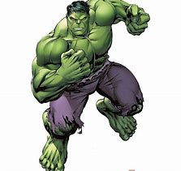
Green Dots
Can you find this on your sheet
Hulk

Slide 14
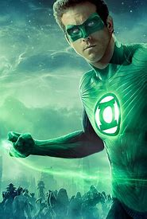
Green Zig Zags - Left to Right
Can you find this on your sheet
Green lantern

Slide 16
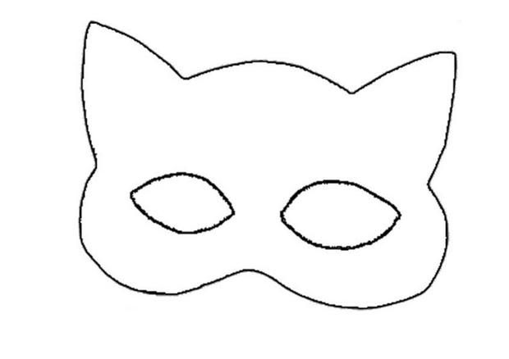
Red Dashes
Can you find this on your sheet
Catwoman

